Slide 1

Religion and Philosophy
THE SIKHS (KHALSA)

Slide 2



THEIR PHILOSOPHY
The Sikh religion is strictly monotheistic, believing in One Supreme God. Absolute yet All-pervading, the Eternal, the Creator, the Cause of Causes, without enmity, without hate, both Immanent in His creation and beyond it.
It is no longer the God of one nation, but the GOD OF GRACE.
That being so, He creates man not to punish him for his sins, but for the realization of his true purpose in the cosmos and to merge in from where he issued forth.

Slide 3
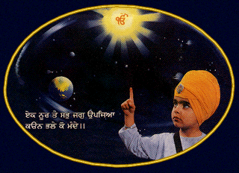
The basic postulate of Sikhism is that life is not sinful in its origin, but having emanated from a Pure Source, the True One abides in it.
Thus sayeth Naanak:
'O my mind, thou art the spark of the Supreme Light;
know thy essence.'

Slide 4
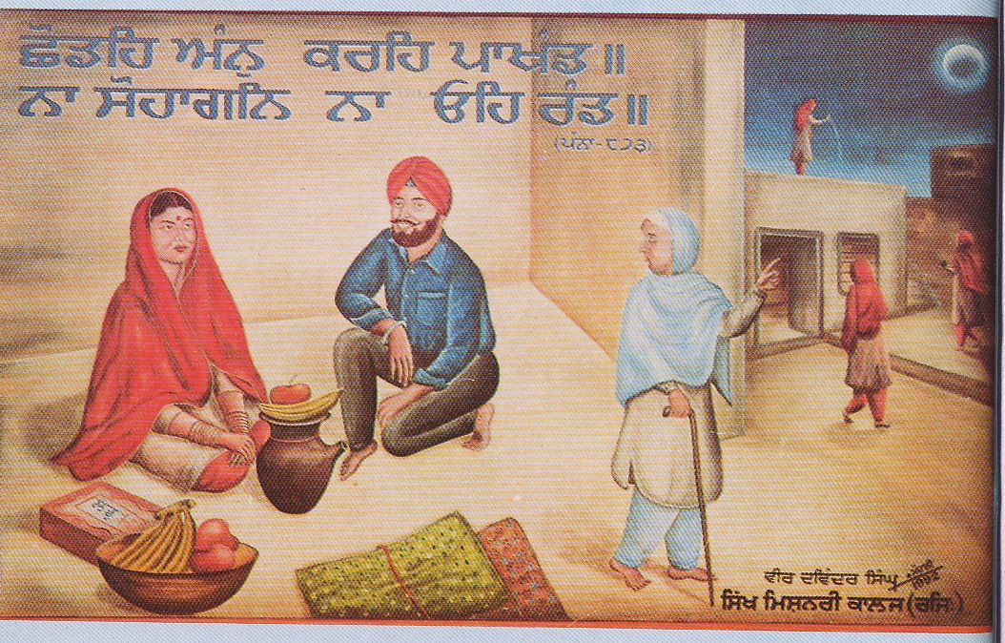
Not only the whole of Sikh Philosophy, but the whole of Sikh history and character flows from 'this principle'.
The Sikhs do not recognise the caste system nor do they believe in Idol-worship, rituals or superstitions.
The gods and goddesses are considered as nonentities.

Slide 5
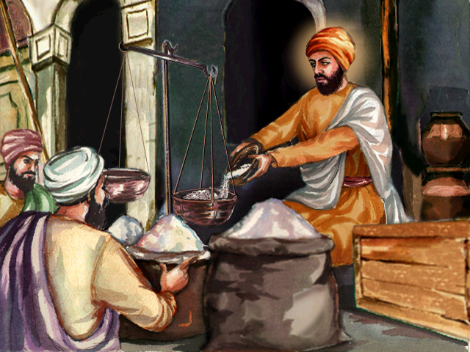
This religion consists of practical living, in rendering service to humanity and engendering tolerance and brotherly love towards all.
The Sikh Guru's did not advocate retirement from the world in order to attaining salvation.
It can be achieved by any one who earns an honest living and leads a normal life and shares his/her earnings with the needy.
'He alone, O Nanak, knoweth the Way who earneth with the sweat of his brow and then shareth it with the others'. SGGS Page 1245

Slide 6

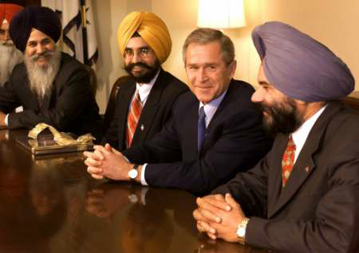
The Guru's gave new hope to the down-trodden mankind to join his fraternity as equals.
He is a creator of the NEW MAN in the New World supported by a New morality.
Riches and personal possessions are not hinderence in living by spiritual ideals.
Sikhism does not believe in the maxim, "It is easier for a camel to go through the eyes of a needle than for a rich man to enter into the kingdom of God"
On the other hand the Sikh dictum is as under:
'They, who are attuned to the Lord by the Guru's Grace, Attain to the Lord in the midst of Maayiaa, (i.e., Worldly Illusions/Wealth).' (SGGS 921)
Riches and personal possessions are not hindrance in living by spiritual ideals.

Slide 7
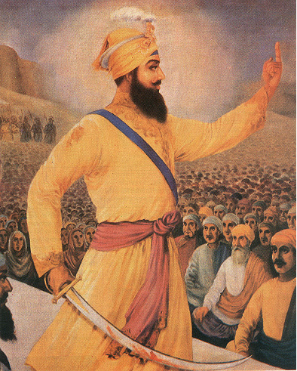
Sikhism does not accept the ideology of pessimism.
It advocates self-confidence, optimism and hope.
The maxim, "Resist not evil but whosoever shall smite thee onto the right cheek, turn to him the other also", does not find any place in Sikh way of life.
On the other hand it enjoins its followers to practice self-determination, self-respect, and self-defence :
"When an affair is past every other remedy,
It is righteous, indeed, to unsheath the sword."
(Guru Gobind Singh Jee)

